Slide 1

Movie Recommendation System
Presented by:- Mohammad Ashraf

Slide 2

Primary Objective
we aim to collect data on the top-rated movies from IMDb using web scraping techniques. We will then proceed to clean and preprocess this data for analysis. Subsequently, we will conduct Exploratory Data Analysis (EDA) to gain insights from the dataset. Finally, we will use the insights obtained to develop a movie recommendation system and create a web page to facilitate user movie searches based on their preferences.

Slide 3
OUR APPROACH FOR THE PROJECT
WEB SCRAPPING – RETRIEVING DATA FROM IMDB WEBSITE
WEB SCRAPPING – RETRIEVING DATA FROM IMDB WEBSITE
WEB SCRAPPING – RETRIEVING DATA FROM IMDB WEBSITE
WEB SCRAPPING – RETRIEVING DATA FROM IMDB WEBSITE

Slide 4
Project Phases
Data Collection:-
Utilize web scraping libraries (e.g., Beautiful Soup,) to extract information on top-rated movies from IMDb.
Collect data on movie titles, ratings, genres, release dates, and other relevant attributes.
Data Cleaning and Preprocessing:-
Handle missing or inconsistent data.
Standardize data formats and units.
Remove duplicates and irrelevant information.

Slide 5
Exploratory Data Analysis (EDA):-
Visualize the distribution of movie ratings, genres, and release years.
Identify trends, correlations, and outliers.
Explore factors affecting movie ratings, such as genre or director.
Movie Recommendation System:-
Develop a recommendation system using techniques like collaborative filtering or content-based filtering.
Allow users to input their preferences (e.g., favorite genres, actors, Year , Certificate).
Recommend movies based on user input and historical IMDb data.

Slide 6
Web Page Development:-
Create a user-friendly web page for movie searching and recommendations.
Implement an interface for users to input their preferences.
Display movie recommendations based on user input.
Conclusion:-
By completing this project, we will not only collect and analyze data on top IMDb movies but also provide a valuable tool for users to discover and explore movies tailored to their preferences. The recommendation system and web page will enhance the user experience and provide actionable insights for the movie industry.

Slide 7
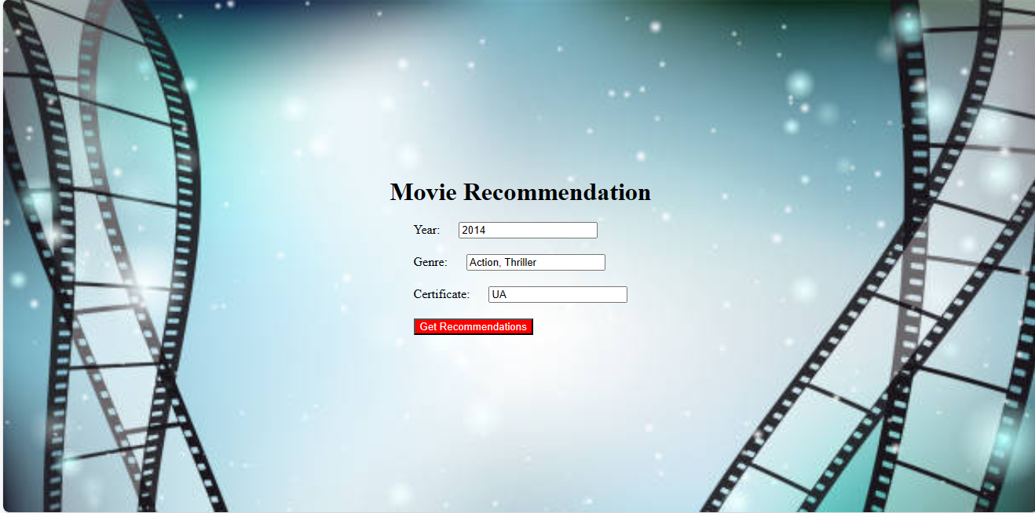
Input Web Page
When User click on Get Recommendation button Output Recommended Movie Page Open In Next Tab

Slide 8
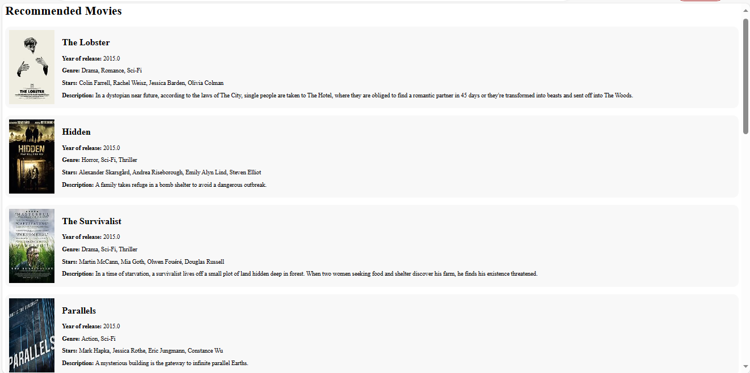
Output Web Page
Movie Thumbnail
Name of Movie
Year of Movie Release
Type of Movie
Name of Leading Star in Movie
Short Summary of Movie

Slide 9
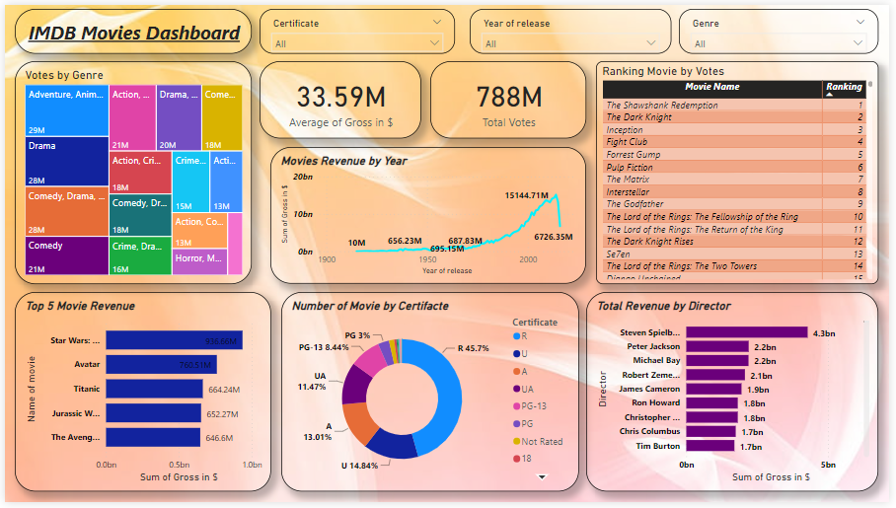

Slide 10

Insights
Certificate : It appears that a significant portion of movies have an R rating. This suggests that there is a market for more mature and potentially intense content in the film industry.
Directors : Both Woody Allen and Alfred Hitchcock are renowned directors who have each directed approximately 50 movies. This speaks to their prolific careers in the film industry.
Gross Collection Trend (1900-2020): Over the years from 1900 to 2020, the gross collection of movies has been continuously increasing. This could be attributed to various factors, such as inflation, population growth, and the global expansion of the film industry.
Movie Ratings: The majority of movies fall into the "Medium" rating category, accounting for approximately 57% of films, followed by "High" rating movies at around 35%. This indicates that a substantial portion of movies is produced with a broad audience in mind.

Slide 11
Insights
Top Revenue Movies: "Star Wars," "Avatar," and "Titanic" are identified as the top revenue-generating movies. These blockbusters have achieved immense financial success in the film industry.
High-Revenue Directors: Steven Spielberg, Peter Jackson, and Michael Bay are noted as directors who have achieved the highest revenue from their movies. This suggests their ability to create commercially successful films.
Popular Genres: Adventure, animation, and comedy are mentioned as the genres that receive the highest votes from audiences. These genres often attract a wide range of viewers due to their entertainment value.
Top-Voted Movies: "The Shawshank Redemption," "The Dark Knight," and "Inception" are highlighted as the movies with the highest votes. These films have resonated with audiences and are considered classics by many.

Slide 12

Conclusion
In this project, we successfully collected a dataset containing information on 10,000 movies from IMDb using web scraping techniques. Through extensive Exploratory Data Analysis (EDA) and visualization, we unearthed valuable insights and relationships within the dataset. These insights included trends in movie ratings, genre popularity, and the impact of various factors on movie success.
To make the data more accessible and actionable, we leveraged Power BI to create interactive and insightful dashboards. These dashboards allow for easy visualization and exploration of the movie data, making it a valuable resource for decision-makers in the film industry.
Furthermore, we developed a movie recommendation system that empowers users to find top movies tailored to their preferences. This recommendation model takes user inputs such as release year, genre, and certification, and generates personalized movie suggestions. By deploying this model on a web page using Flask, we've made it accessible to a broader audience, enhancing the user experience and promoting movie discovery.
Overall, this project not only demonstrated our ability to gather, clean, and analyze data but also highlighted the practical applications of data-driven insights in the entertainment industry. It provides a powerful tool for both industry professionals and movie enthusiasts to make informed decisions and discover the best movies that align with their preferences.

Slide 13
Challenges Faced:-
Web scraping IMDb for movie data was challenging due to the website's frequent updates and dynamic structure, necessitating ongoing script adjustments to maintain data collection.
The collected dataset often contained missing or inconsistent data, making thorough data cleaning and preprocessing vital to ensure data accuracy and reliability for analysis.
Designing a user-friendly web page for movie searches and recommendations, along with deploying the recommendation model using Flask, involved considerations like server hosting, scalability, and ensuring a seamless user experience, adding complexity to the project's execution.

Slide 14


